Slide 1
Becode
Septembre 2018
Degroof Petercam Challenge
Silvia Steisel

Slide 2
1
2
Degroof Petercam Foundation
Degroof Petercam Challenge
3
4
Our needs
Evaluation criteria

Slide 3
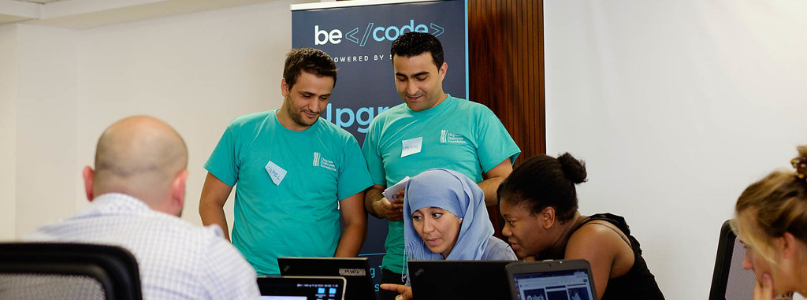
1
Degroof Petercam Foundation

Slide 4

2
Degroof Petercam Challenge
Create an app’
Name it
3 days
Ultimate mission on Friday 28/9
9 teams of 5 people + coaches
1 jury
1 winning team and 1 laureate

Slide 5

3
Our needs: matching skills with projects
We allow every employee to spend 2h/month to give his skills to others
Employees have specific skills ex: accountability, HR, management, finance, IT
The foundation selects projects that could benefit from those skills
The projects receive time and skills from our employees to become stronger

Slide 6

3
Our needs: an app’
A personal account where you can enter the skills you want to share and personal details (country, region, age)
ex: Silvia Steisel, based Brussels, skills: communication, HR, French, Dutch, English
A list of projects with missions that need skills you have
ex: Becode needs HR trainers
Apply to a project that sends an automated email to the project + foundation with his profile details
An inbox or alert system that tells you if you have the mission
A dashboard to manage your mission: puts the date in your outlook agenda, an automated counter tells you how much time you have spend
You can rate the project

Slide 7
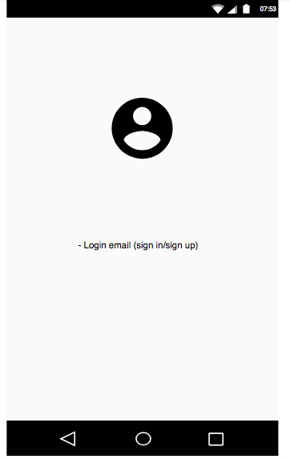
3
Our needs: mockup’
Login page

Slide 8
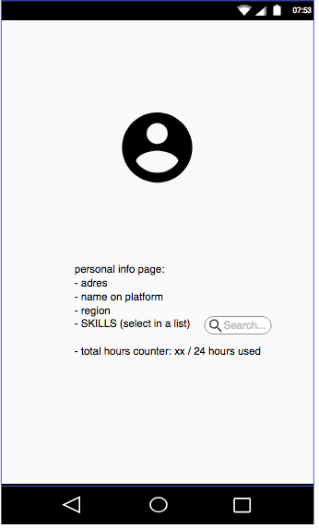
Personal page

Slide 9
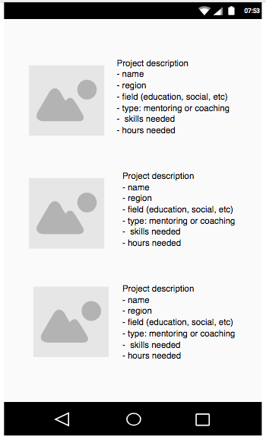
Project list

Slide 10
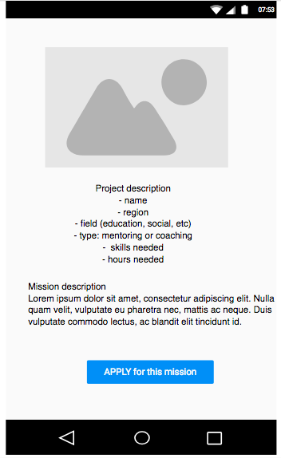
Project page

Slide 11
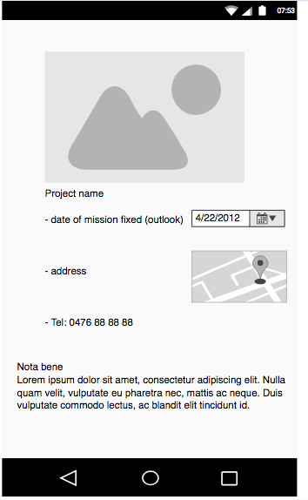
Mission page

Slide 12
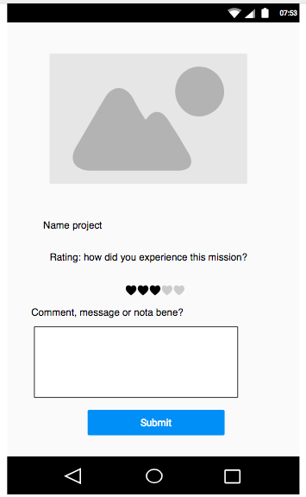
After mission

Slide 13
4
Evaluation criteria
Phase\Equipe |  | Points | Team 1 | Team 2 | Team 3
Phase I : | Qualité de l’analyse | 2
 | Evaluation du contenu par le business ( par rapport au besoin initial ) | 5
Phase II | Qualité du document de conception | 2
 | Clarté de la conception | 3
 | Méthodologie de conception | 2
Phase III | Conformité de la réalisation par rapport à la conception | 2
 | Fonctionnement de l’application ( boutons, écrans,…) | 5
 | Qualité du code | 2
 | Ergonomie de l’application ( respect du thème , logo…) | 2
Bonus | Outils extra ( versionning,…) | 2
 | Méthodologie de travail en équipe et organisation | 3
Score |  | 30

Slide 14

Questions?

Slide 15


Slide 16
^{Silvia Steisel}
^{Rue de l’Industrie 44}
^{1040 Bruxelles}
^{s.steisel@degroofpetercam.com}

